Slide 1
Custom Designing a Quad-Core Processing Computer
By Derrick Skinger

Slide 2
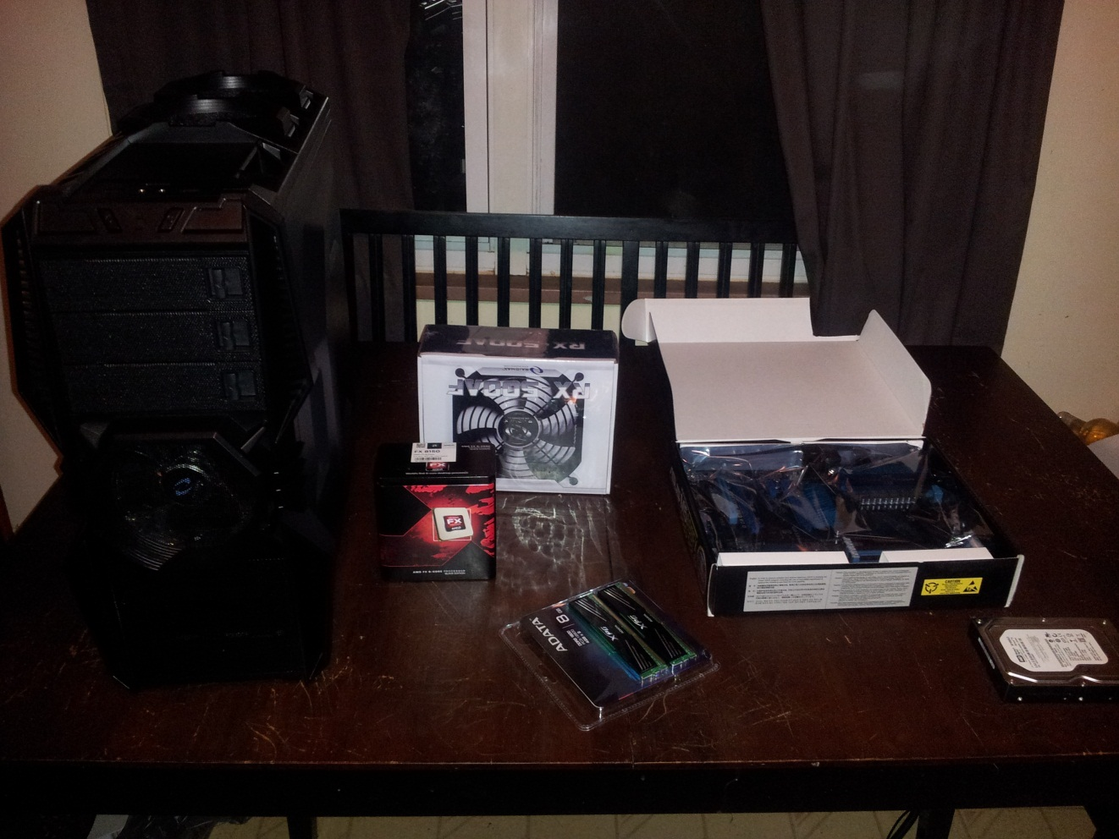
The basic parts
Tower
Central Processing Unit (CPU)
Power Supply
Motherboard
Hard drive
Random Access Memory (RAM)

Slide 3
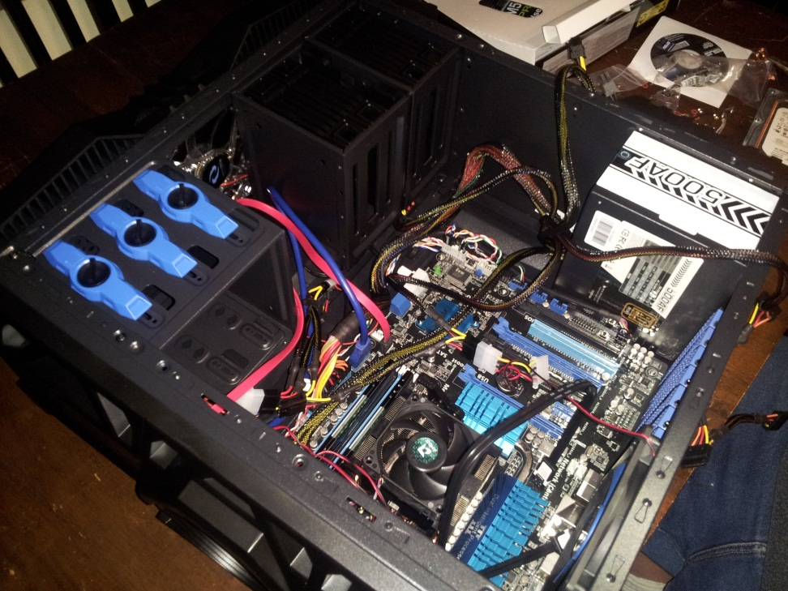
Final Setup
Having acquired the necessary expertise; it was the time to phase into the process of constructing my own computer and compiling the software.

Slide 4
The process of building a computer

Slide 5
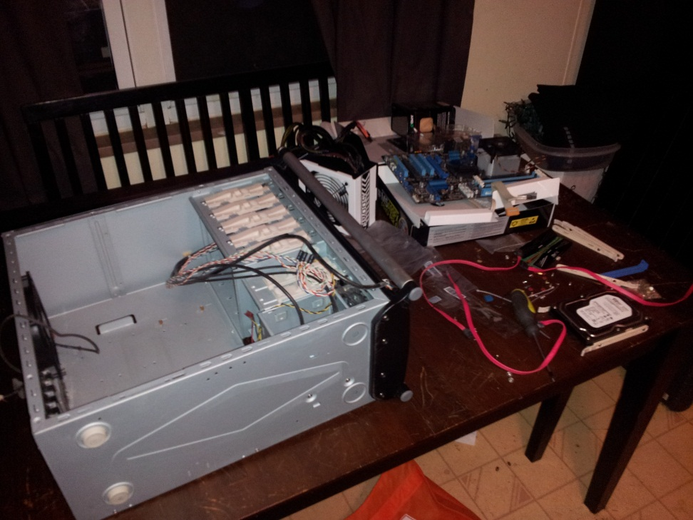
My parts
Gathering all necessary parts together for the proper construction of the final product.
Sources such as new egg, radioshack, and alienware.com were exploited to get the best deals on the highest quality goods.

Slide 6
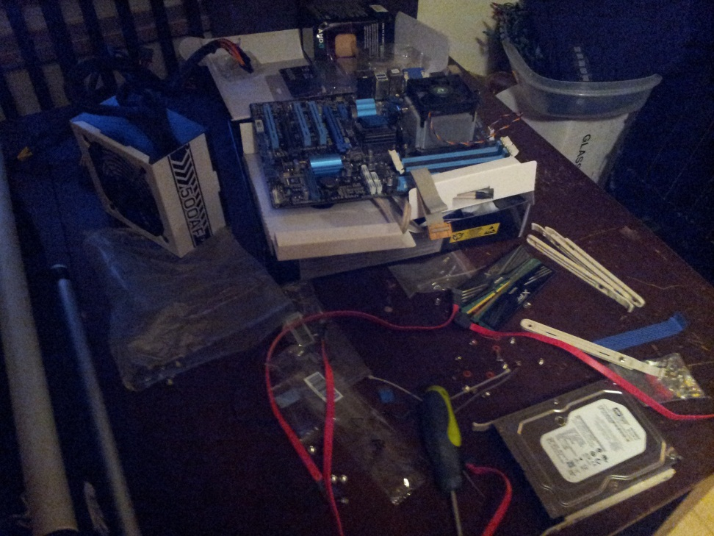
First Step
Setting up the motherboard
Placing Central Processing Unit (CPU) and designated fan
Attaching Random Access memory (RAM)

Slide 7
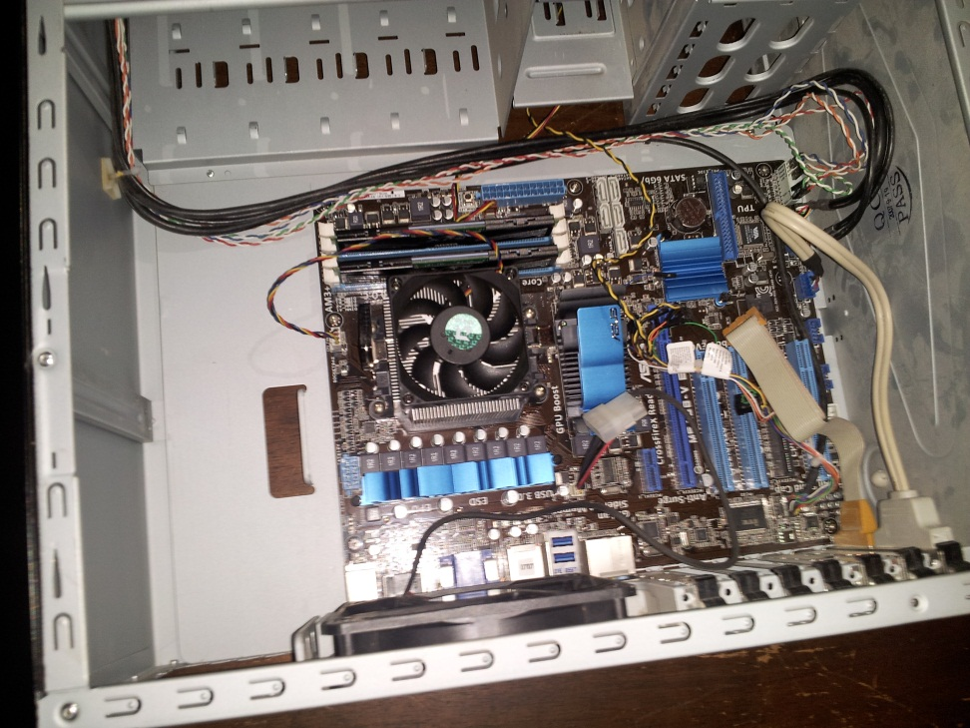
Installing the Motherboard
The second step; attach the motherboard to the inside mounts of the tower and connecting the couplers.

Slide 8
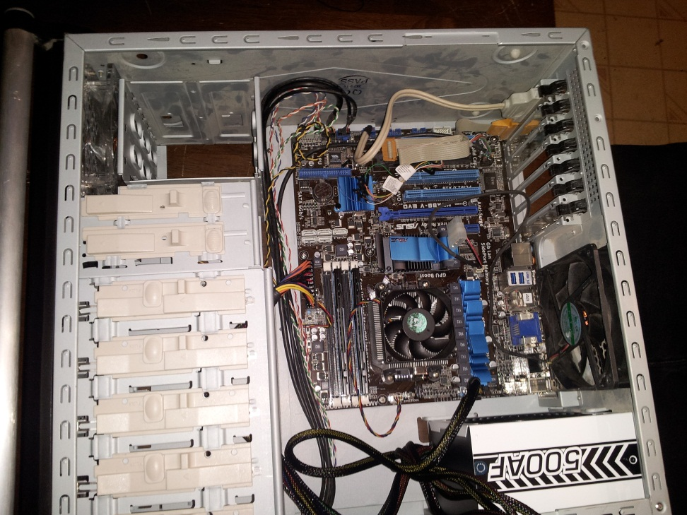
Installing Power Supply
Once docking the power supply is completed, connecting all the proper cables is done.

Slide 9
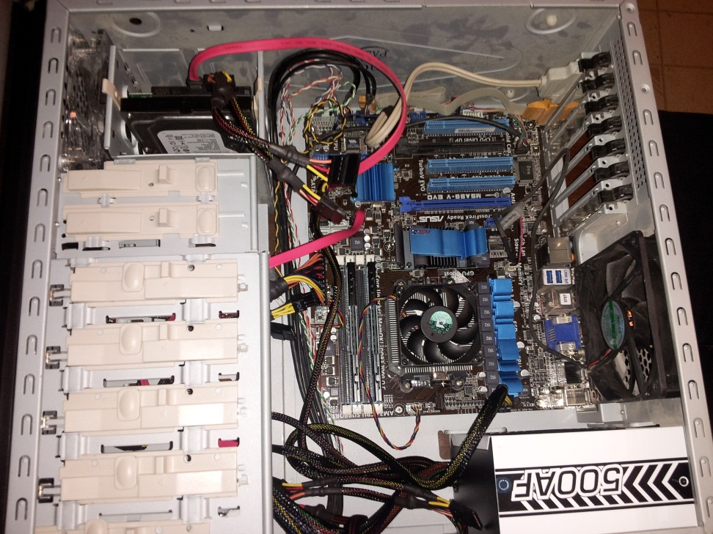
Installing additional drives
Installing optical drive for disk reader operation.
Hard drive installation is necessary.

Slide 10
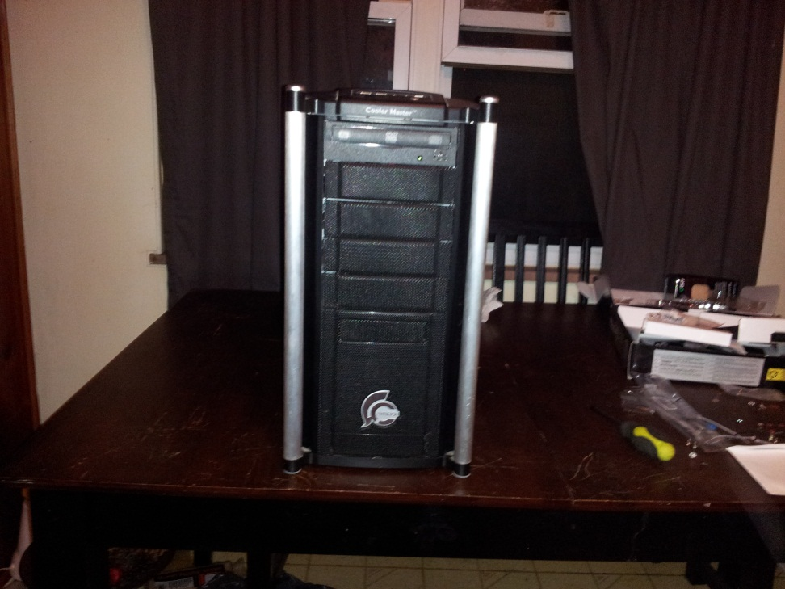
Completed Structure
After double checking everything is applied correctly, it is time to install the Operating System.

Slide 11
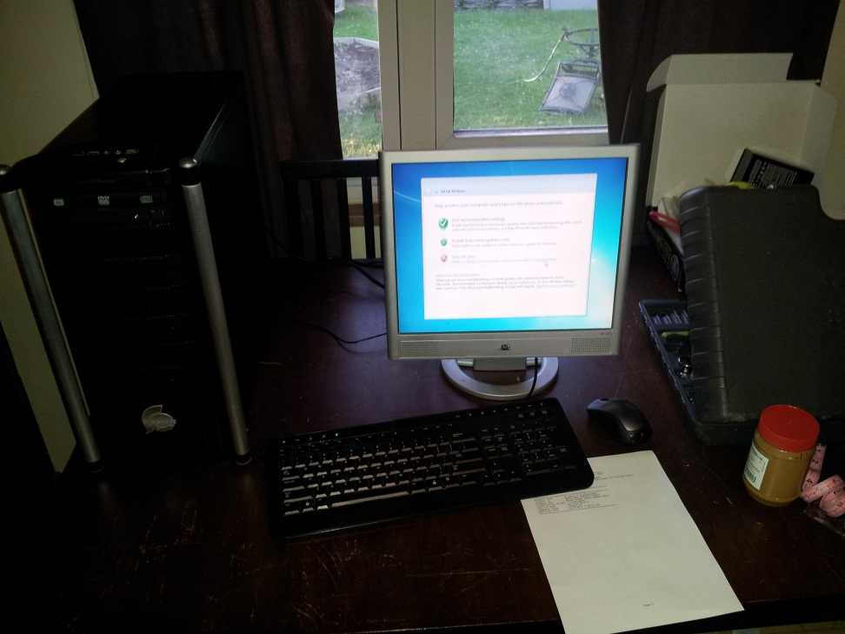
Installing the Operating System
Attach the human interface devices to interact with the computer
Use the setup disk to download Windows 7 to the hard drive

